Slide 1
Unit three- Part One

Slide 2
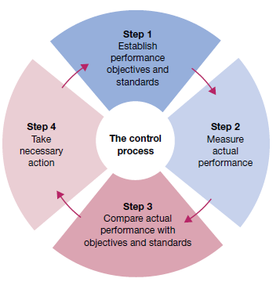

Slide 3
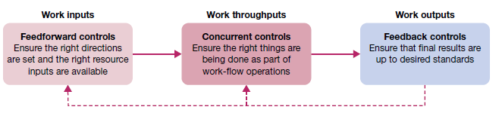

Slide 4
BUDGETARY CONTROL
The establishment of budgets, relating the responsibilities of executives to the requirements of a policy
Revenue and Expense Budgets
Budgets spell out plans for revenues and operating expenses in rupee terms.

Slide 5
Time, Space, Material, and Product Budgets
Many budgets are better expressed in quantities rather than in monetary(money) terms.
Capital Expenditure Budgets
capital expenditures for plant, machinery, equipment, inventories, and other items.

Slide 6
Cash Budgets
cash budget is simply a forecast of cash receipts
Variable Budget
analysis of expense items to determine how individual costs should vary with volume of output
Zero Based Budget
By starting the budget of each package from base zero, budgeters calculate costs

Slide 7
NON-BUDGETARY CONTROL TECHNIQUES
Many traditional control devices not connected with budgets, although some may be related to, and used with, budgetary controls.
Statistical data:
Analysing the numerical data
Break- even point analysis
chart depicts the relationship of sales and expenses

Slide 8
INFORMATION AND FINANCIAL CONTROLS
Liquidity — ability to generate cash to pay bills;
Leverage — ability to earn more in returns than the cost of debt;
Asset management — ability to use resources efficiently and operate at minimum cost;
Profitability — ability to earn revenues greater than costs.

Slide 9
OPERATIONS CONTROL
Purchase Control
Inventory Control
Quality Control
Quality control refers to the technical process that gathers, examines, analyze & report the progress of the project & conformance with the performance requirements

Slide 10
PROJECT MANAGEMENT AND CONTROL
Gantt charts
A Gantt chart, such, graphically displays the scheduling of tasks required to complete a project
CPM/PERT techniques
PERT – Project Evaluation and Review Technique
CPM- Critical Path Method

Slide 11
The difference between Planning and Controlling.
Basis | Planning | Controlling
Meaning | It is the first step on deciding what to do, how, where and when a specific work has to be done | Controlling is the main goal and responsibilities of all management in any enterprises.
Function | Planning is about looking ahead | Controlling is looking back
Process | It is the first process in building a business | It is the last structure any business
Features | Planning, arranging, employee, direction | Controls all the planning features

